Slide 2
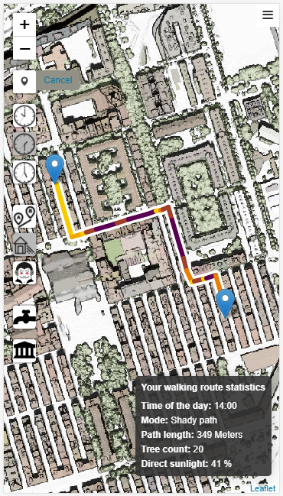
Introduction
Barcelona Climate Plan has an action line with the purpose of avoiding excessive heat to citizens.
Cool Walks is a tool that generates fresh and cool routes through sidewalks and pedestrian crossings while using modeled shades throughout the day.
Cool Walks guides you through the city preventing excessive heat.
Check it yourself at:
http://www2.bcnregional.com/

Slide 3
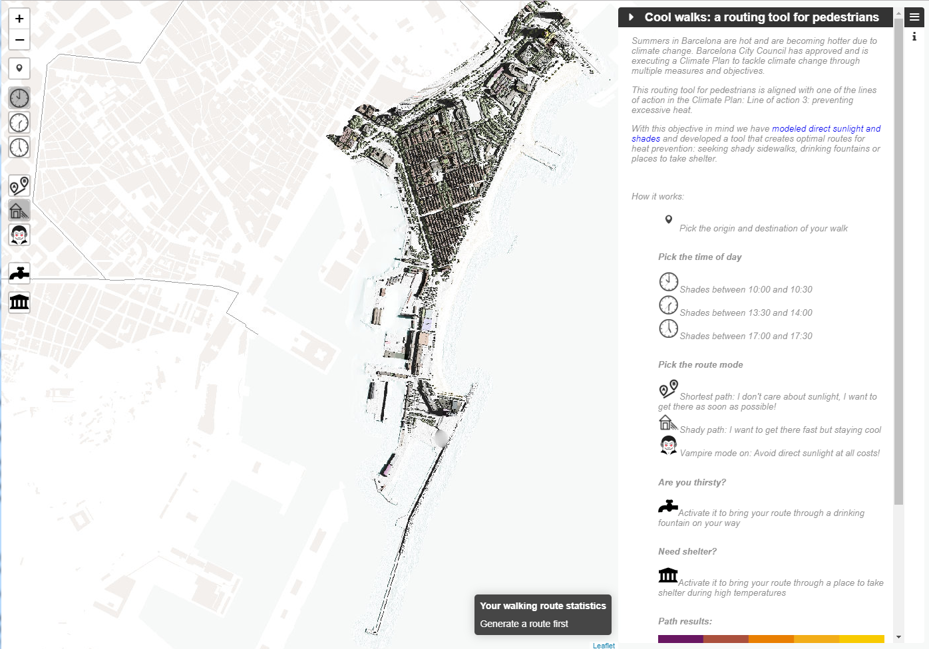
How it works…

Slide 4
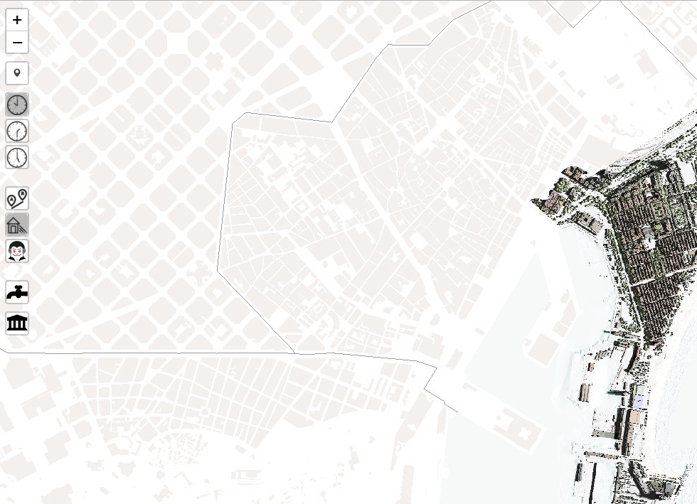
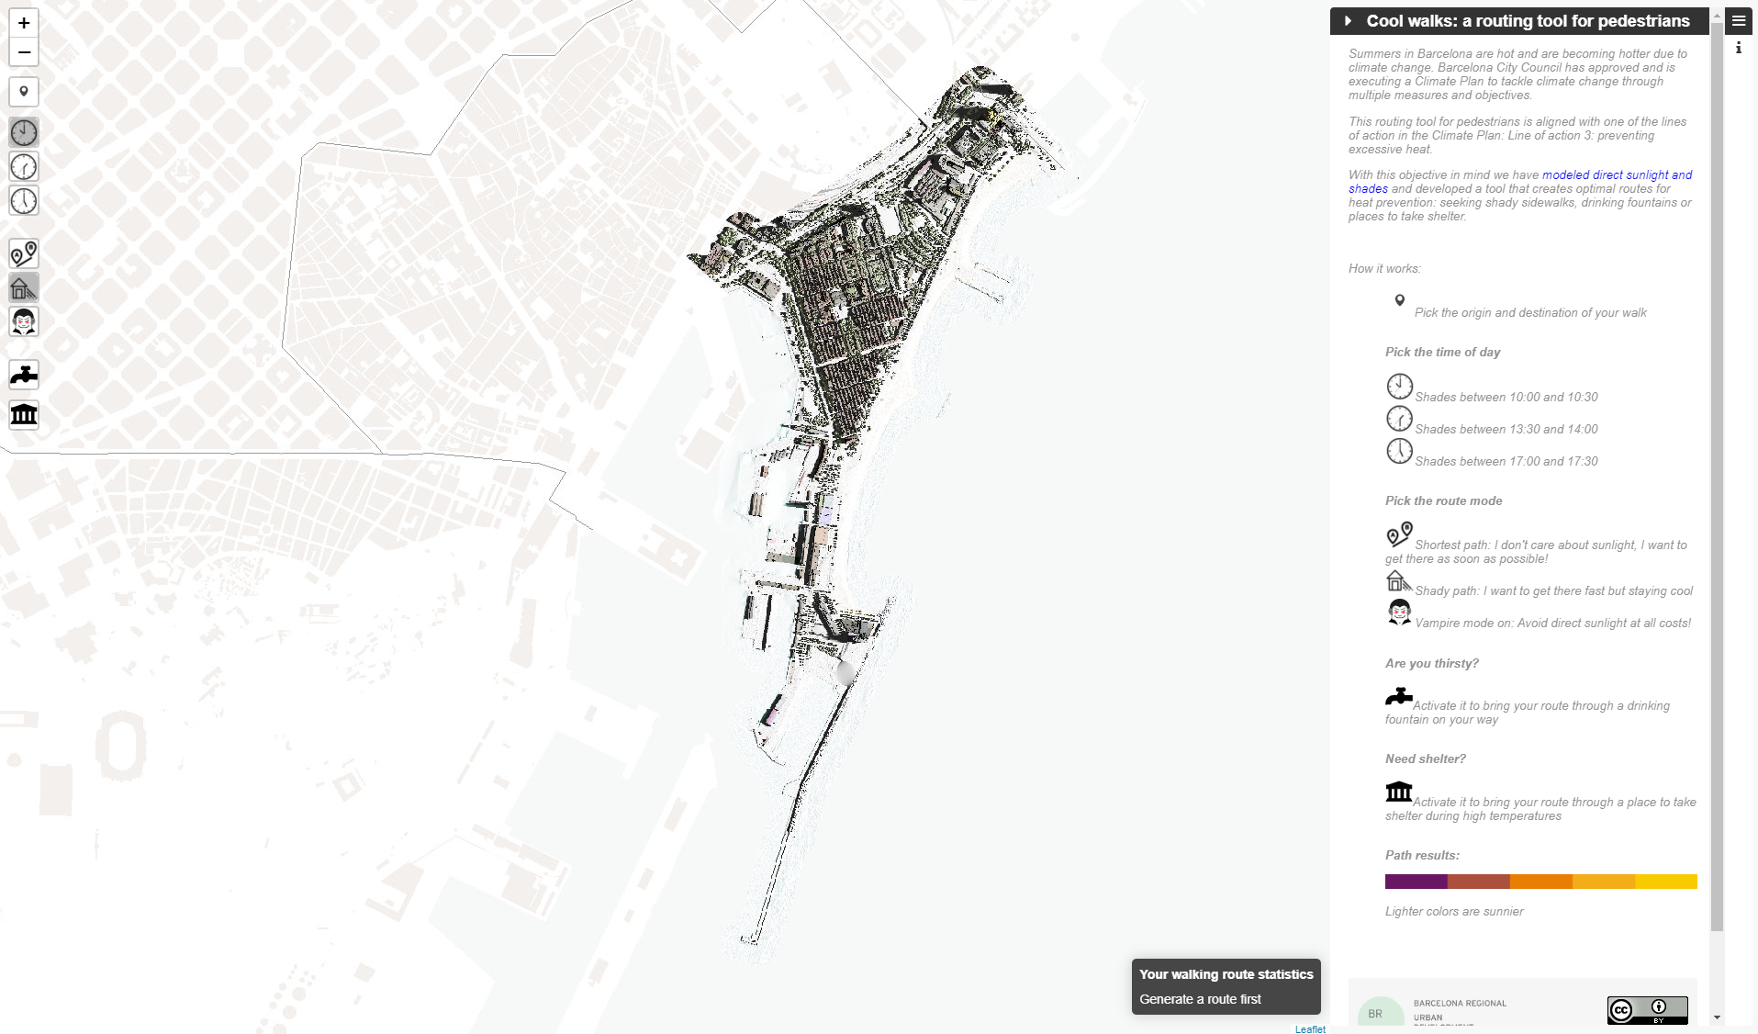
How it works…
Zoom in / out
Pick the origin and destination of your walk
Shades between 10:00 and 10:30
Shades between 13:30 and 14:00
Pick the time of the day
Shades between 17:00 and 17:30
Shortest path: I don't care about sunlight, I want to get there as soon as possible!
Shady path: I want to get there fast but staying cool
Pick the route mode
Vampire mode on: Avoid direct sunlight at all costs!
If you are thirsty, bring your route through a drinking fountain on your way
If you need a shelter, bring your route through a place to take shelter during high temperatures

Slide 5
How it works…
Information about the different parts of the routing tool and how to use it

Slide 6
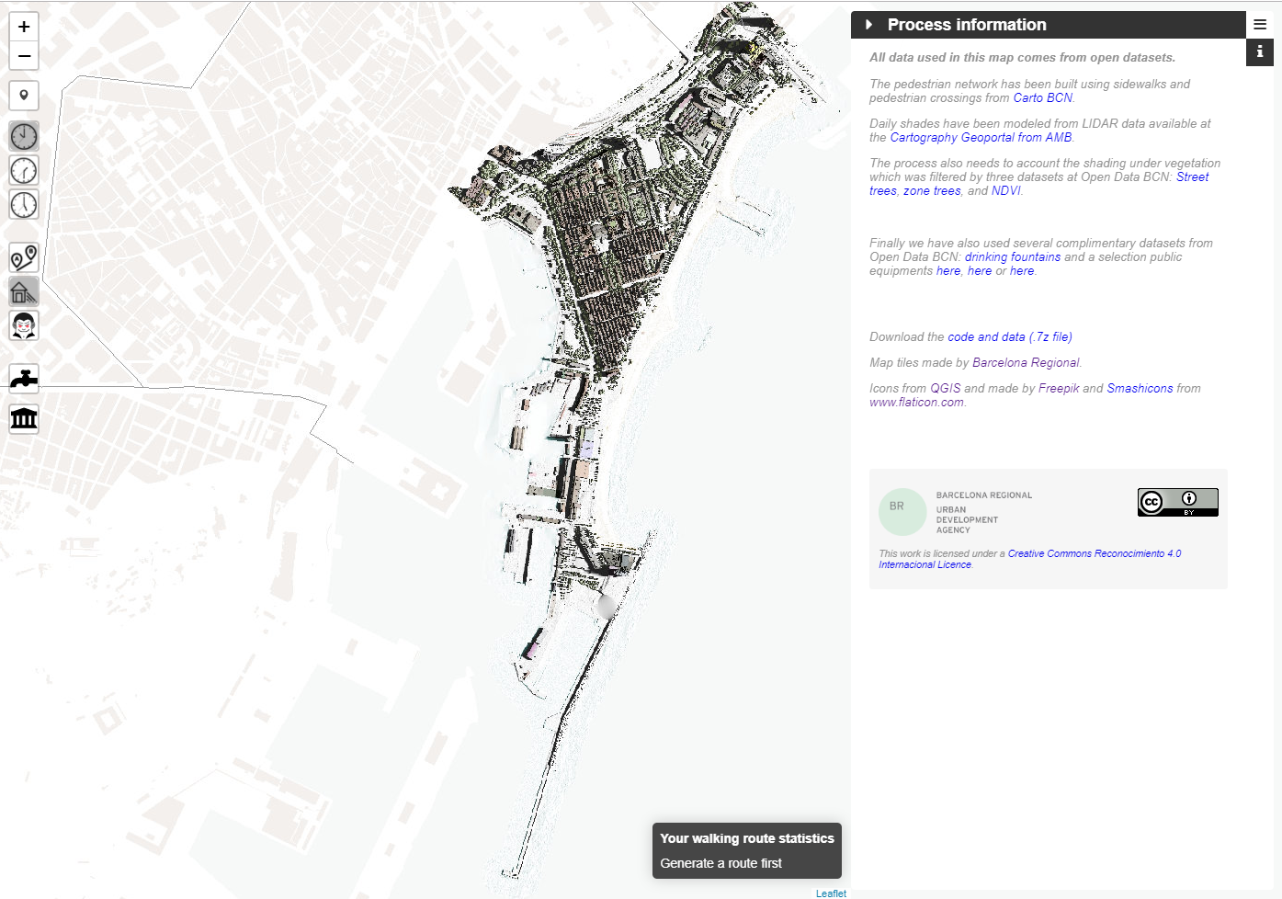
How it works…
Information about used data and downloading link

Slide 7
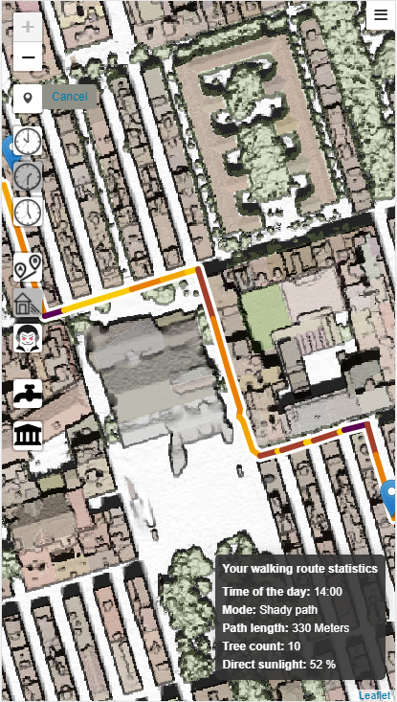
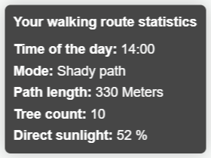
How it works…
Route Statistics
Yes, it is responsive!

Slide 8
Video Demo

Slide 9
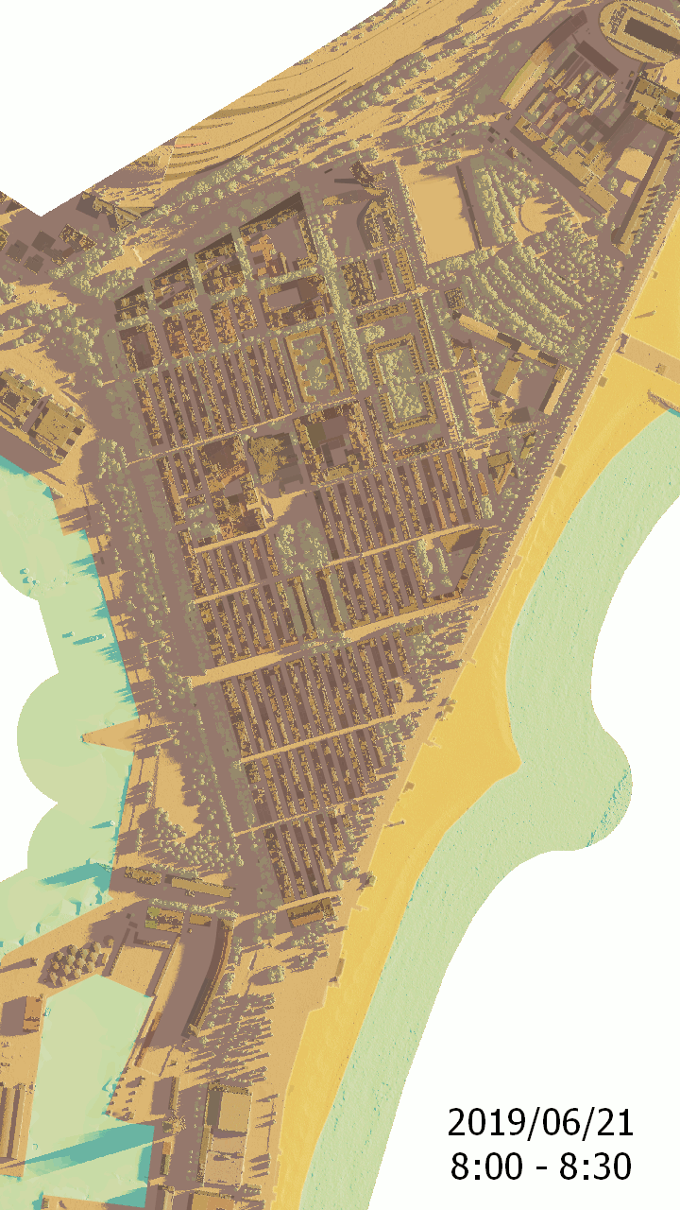
Shade modeling and network building
Steps Summary
3D model of our area of interest using LIDAR data
Calculation of all shades during a whole day
Network for pedestrians using all sidewalks, crossings and open public spaces
Public space surface
Green shading from trees
Shading statistics at public surface
Network impedance: routing “cost” for each mode and time of day

Slide 10
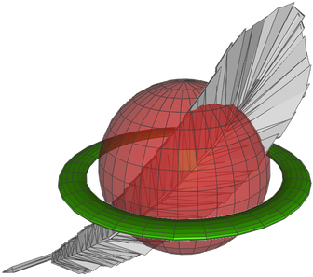
App architecture
Generation of a custom Web Map Service
Network data with cost impedance is stored in a Spatialite database
The interactive web map was built on the leaflet.js library
Route generation makes use of the Spatialite “Virtual Network” module

Slide 11
Public datasets
Street trees from Open Data BCN
https://opendata-ajuntament.barcelona.cat/data/en/dataset/arbrat-viari
Zone trees from Open Data BCN
https://opendata-ajuntament.barcelona.cat/data/en/dataset/arbrat-zona
Vegetation index NDVI from Open Data BCN
https://opendata-ajuntament.barcelona.cat/data/en/dataset/cobertura-vegetal-ndvi
Drinking fountains from Open Data BCN
https://opendata-ajuntament.barcelona.cat/data/en/dataset/fonts
Public amenities for heat shelters from Open Data BCN
https://opendata-ajuntament.barcelona.cat/data/en/dataset/mercats-municipals
https://opendata-ajuntament.barcelona.cat/data/en/dataset/equipament-cultura-i-lleure
https://opendata-ajuntament.barcelona.cat/data/en/dataset/educacio-ensenyament-reglat
Topographic cartography from Carto BCN
https://w20.bcn.cat/cartobcn/default.aspx?lang=en
LIDAR data from Geoportal AMB
https://geoportalcartografia.amb.cat/AppGeoportalCartografia2/index.html
Sentinel-2 data from ESA
https://scihub.copernicus.eu/dhus/#/home

