Slide 1
Identifying Problem Areas in Barcelona’s Bike Lanes
Josep Espasa, Claire Kelley, Paolo Chevalier, Amos Chinomona

Slide 2
Data Sources
Bike Accidents (2017)
Complaints (2018)
Bike Paths
Neighborhood Age and Income (2016)
Bike usage omnibus (2015-2017)

Slide 3
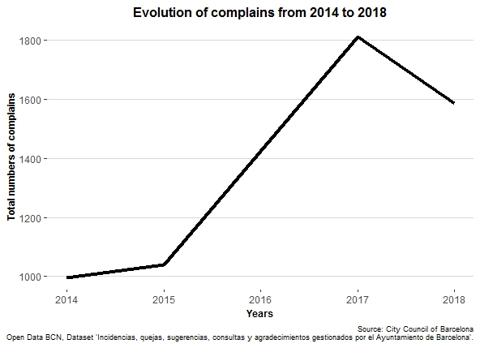
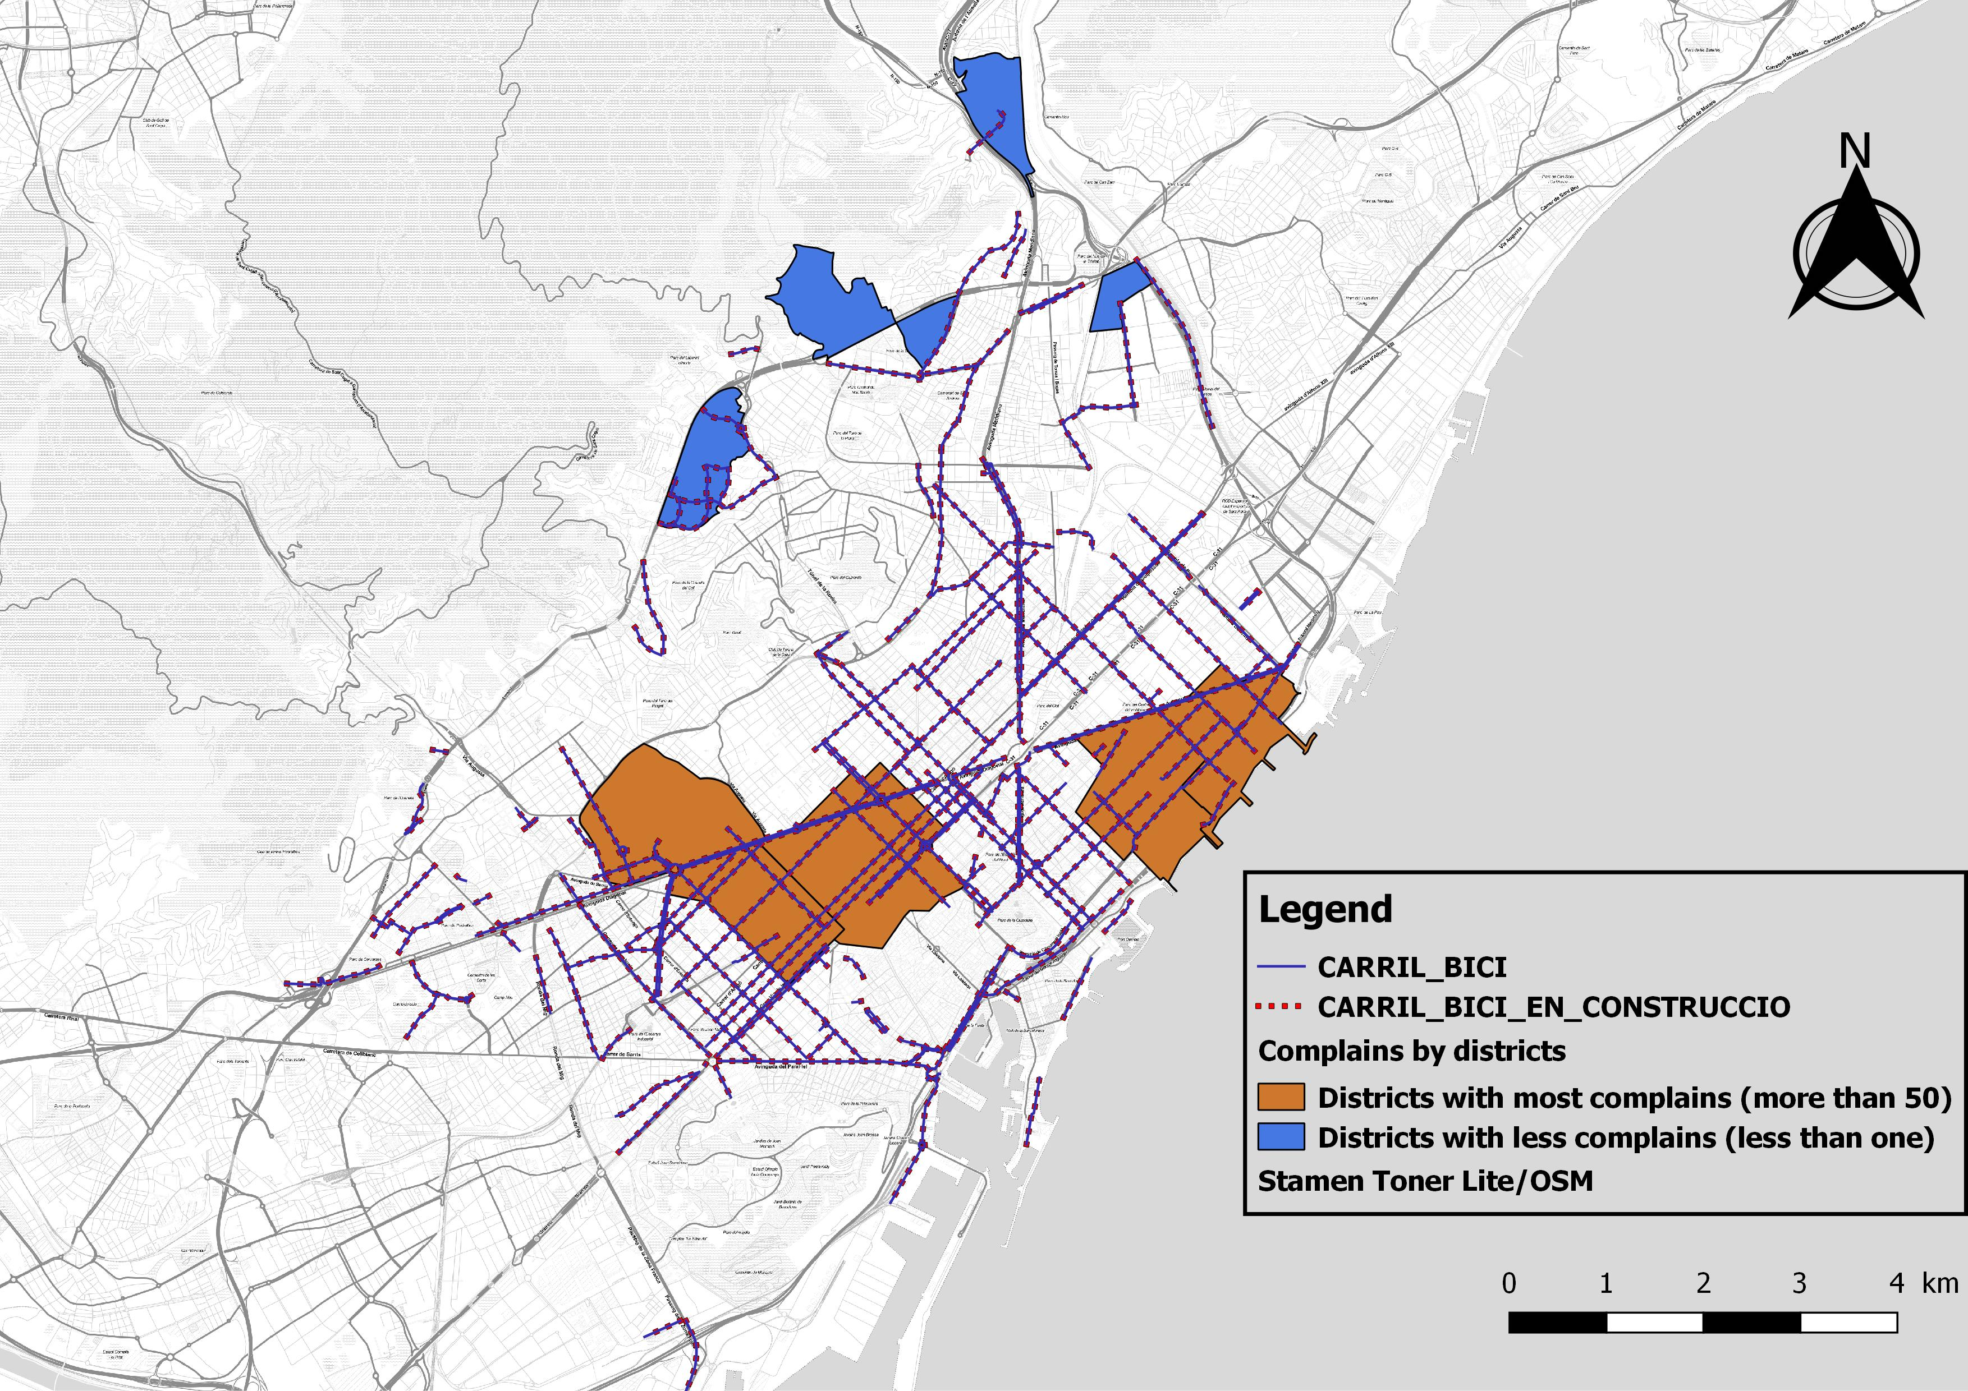
 | 2014 | 2015 | 2017 | 2018
New bicycle lane (change of location) | 10% | 11% | 21% | 24%
New bicycle parking (change of location) | 21% | 23% | 19% | 22%
Discipline problems with bikes | 21% | 17% | 20% | 21%
Abandonned Bicycles | 20% | 16% | 14% | 13%
Incidents in Bicing services | 8% | 7% | 7% | 5%
Marking Bicycle lane | NA | NA | 1% | 4%
Incidents Bibycle lane | 12% | 13% | 3% | 2%

Slide 4
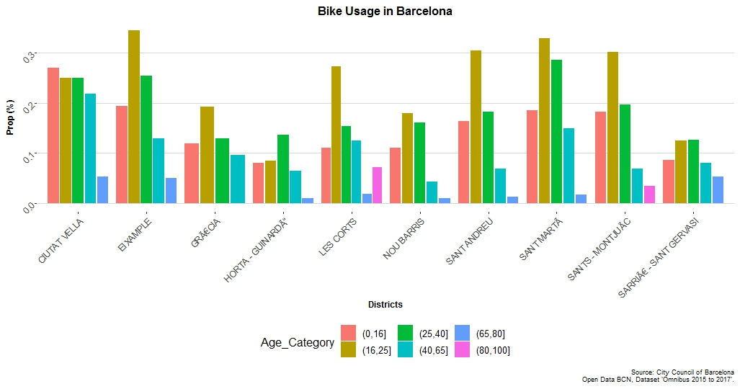

Slide 5
Negative effect of Age

Slide 6
Notes:
Average number of bikes at Bicicling stations per 10k people . Red lines are bike paths

Slide 8
”Hot Spots”
Accidents
Complaints
Notes:
NO clear patterns – Spatial regression

Slide 9
Further Directions
Prioritize expansion of bike lanes based on customer suggestions
Prioritize repair/improvement of signage based on intersections with high accidents rates
Predict Spending on future bike lines based on changes in demand
Further review of equitable access to biking- are certain populations not being served correctly (perhaps parents with children, or older adults)
Analyze Text of Complaints to discover patterns and more specific details

